Slide 1
Adrez Software pvt ltd
Hr Dashboard

Slide 2
Introduction
Adrez Software pvt ltd
Adret Software Pvt. Ltd. is an IT solutions provider that specializes in delivering a wide range of services, including software development, web development, and digital transformation. They focus on building customized technology solutions to help businesses enhance efficiency, improve customer engagement, and drive growth. Their offerings often include cloud solutions, mobile app development, and IT consulting, catering to various industries. Adret Software Pvt. Ltd. is known for its client-centric approach, technical expertise, and innovative solutions that help businesses adapt to the evolving digital landscape.

Slide 3
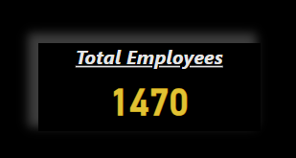
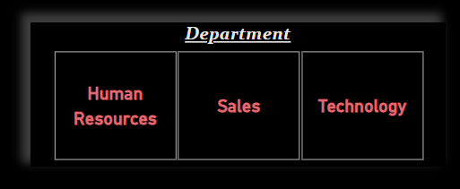
Adrez Software pvt ltd
In Adrez software there are total 1470 employees working on various departments.
DAX Formula used- Tota COUNT(employee[EmployeeID])
There are total 3 departments under which multiple employees have been worked.

Slide 4
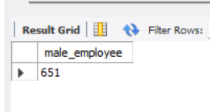
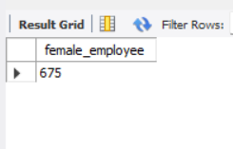
total no of male & female employee
Adrez Software pvt ltd
select count(EmployeeID) as male_employee from hr.employee where Gender="Male";
select count(EmployeeID) as female_employee from hr.employee where Gender=“Female";

Slide 5
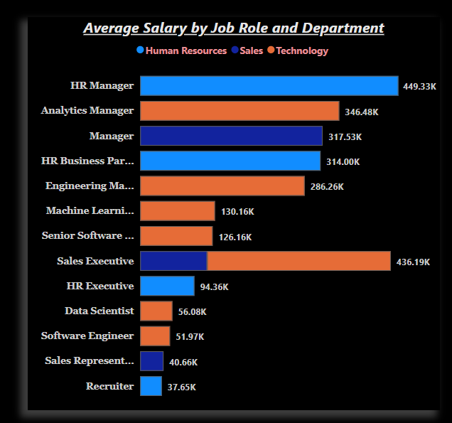
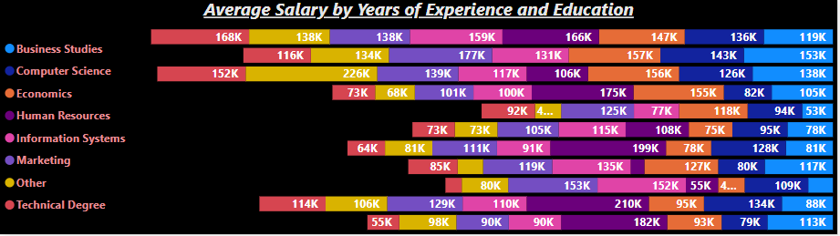
Adrez Software pvt ltd
Insights of average salary by department and job role.
Education level or years of experience impact on employees salary.

Slide 6
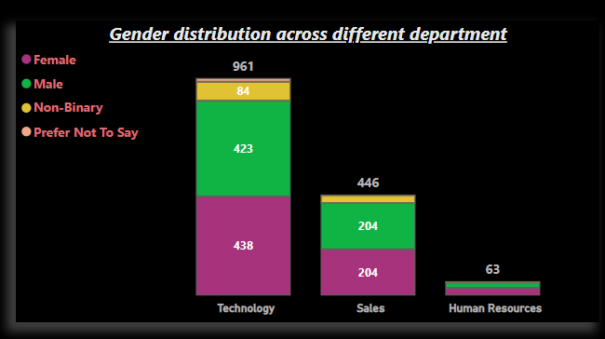
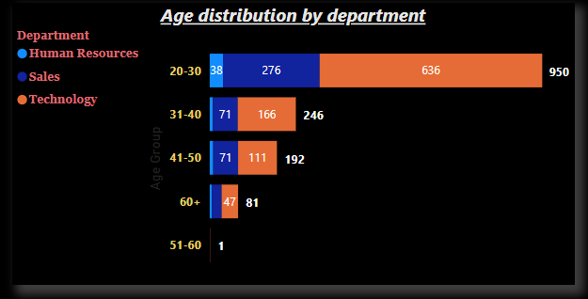
From the above chart we can identify that in “technology” there are 438 male, 423 female, 84 non-binary, 16 prefer not say in “sales” 204 male,204 female, 35 non binary, 3 prefer not to say in “Human Resource” 24 male, 34 female, 5 non binary.
Adrez Software pvt ltd
We can say that in age group 20-30 there are 38 emp from HR,246 emp from sales, 636 emp from Technology in age group 31-40 there are 9 emp from HR,71 from Sales, 166 from Technology and so on.

Slide 7
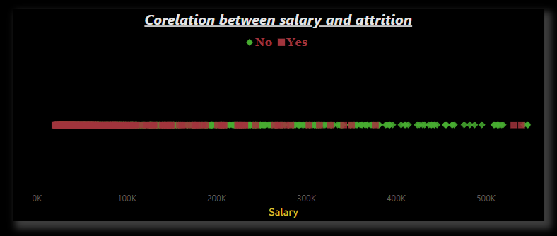
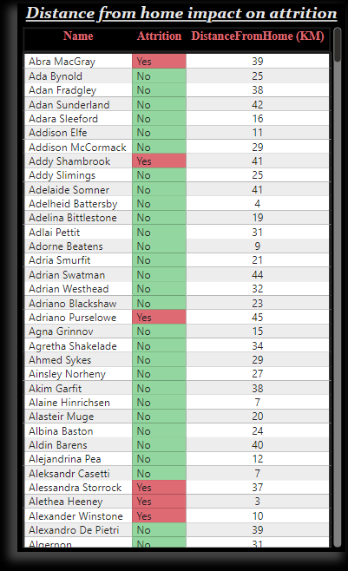
Adrez Software pvt ltd
Employee with low salary are mostly trends of attrition.
Employee with max distance travel from their home are tends of attrition.

Slide 8
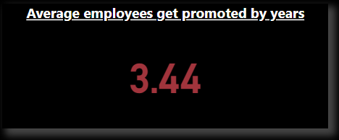
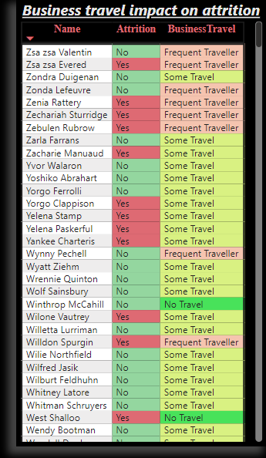
Adrez Software pvt ltd
Employee get promoted by average 3.5 years approx.
Employee with 60% frequent travel and 40% some travel are mostly tends to leave the company and employees with no travel attrition rates are 5%.

Slide 9
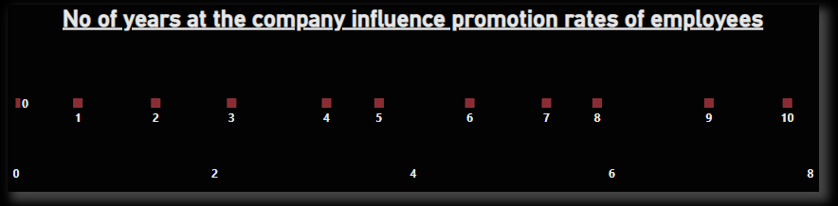
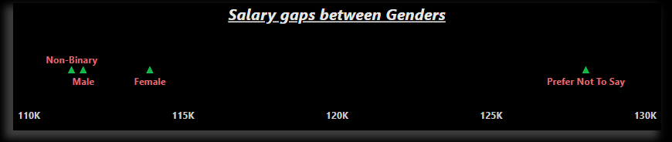
Adrez Software pvt ltd
There is a directly proportion between experience and promotion rates of the employees,
Employee with 10 years of exp has the promotion rate of 7.
Employee with 0 years of experience has the promotion rate of 1.
Average salary of prefer not to say
gender groups Is much high
than the other groups.

Slide 10
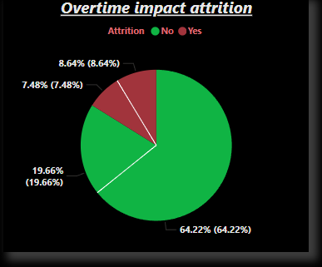
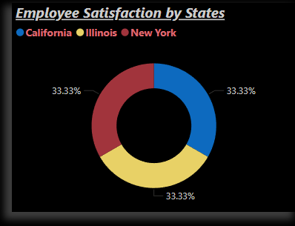
Adrez Software pvt ltd
15% of employee doing overtime are willing to leave the company.
33% of employees from NeyWork, Illinois,
California have rating of 5.

Slide 11
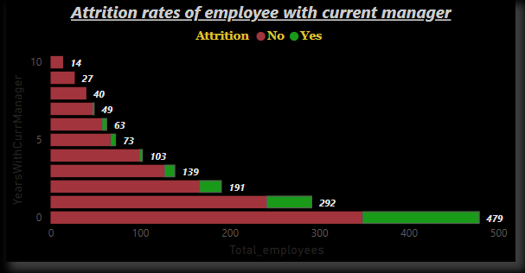
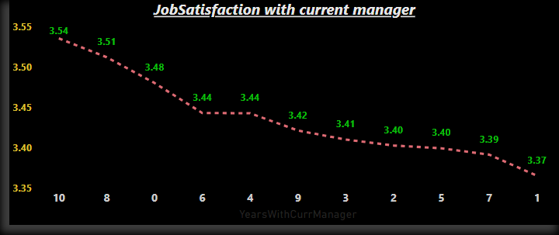
Adrez Software pvt ltd
Higher the employee worked with the current manager having no intention to leave the company, but the employees working for less time are highly possible to leave the company.
Employees who had worked more than 5years with the current manager have give their rating more than 3.40 but also some employees who had worked less than 1year with the manager had given their rating 3.48.

Slide 12
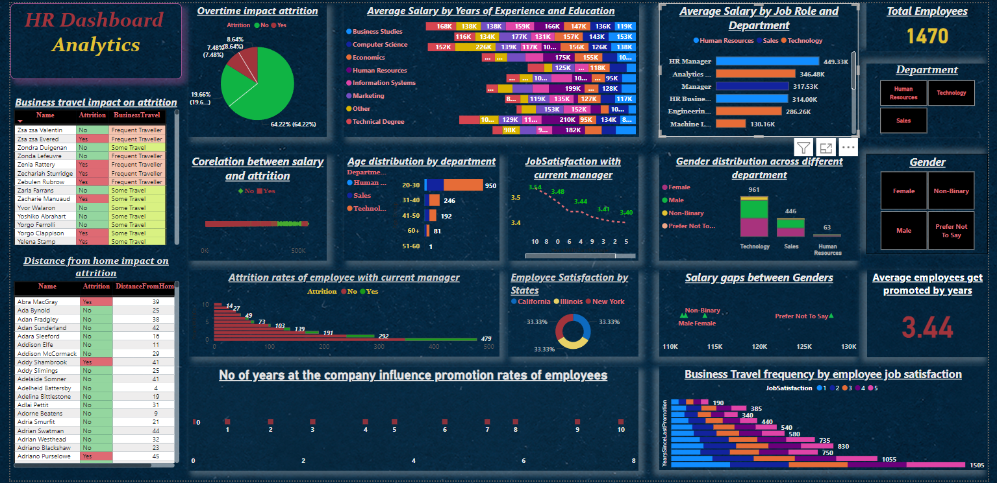

Slide 13
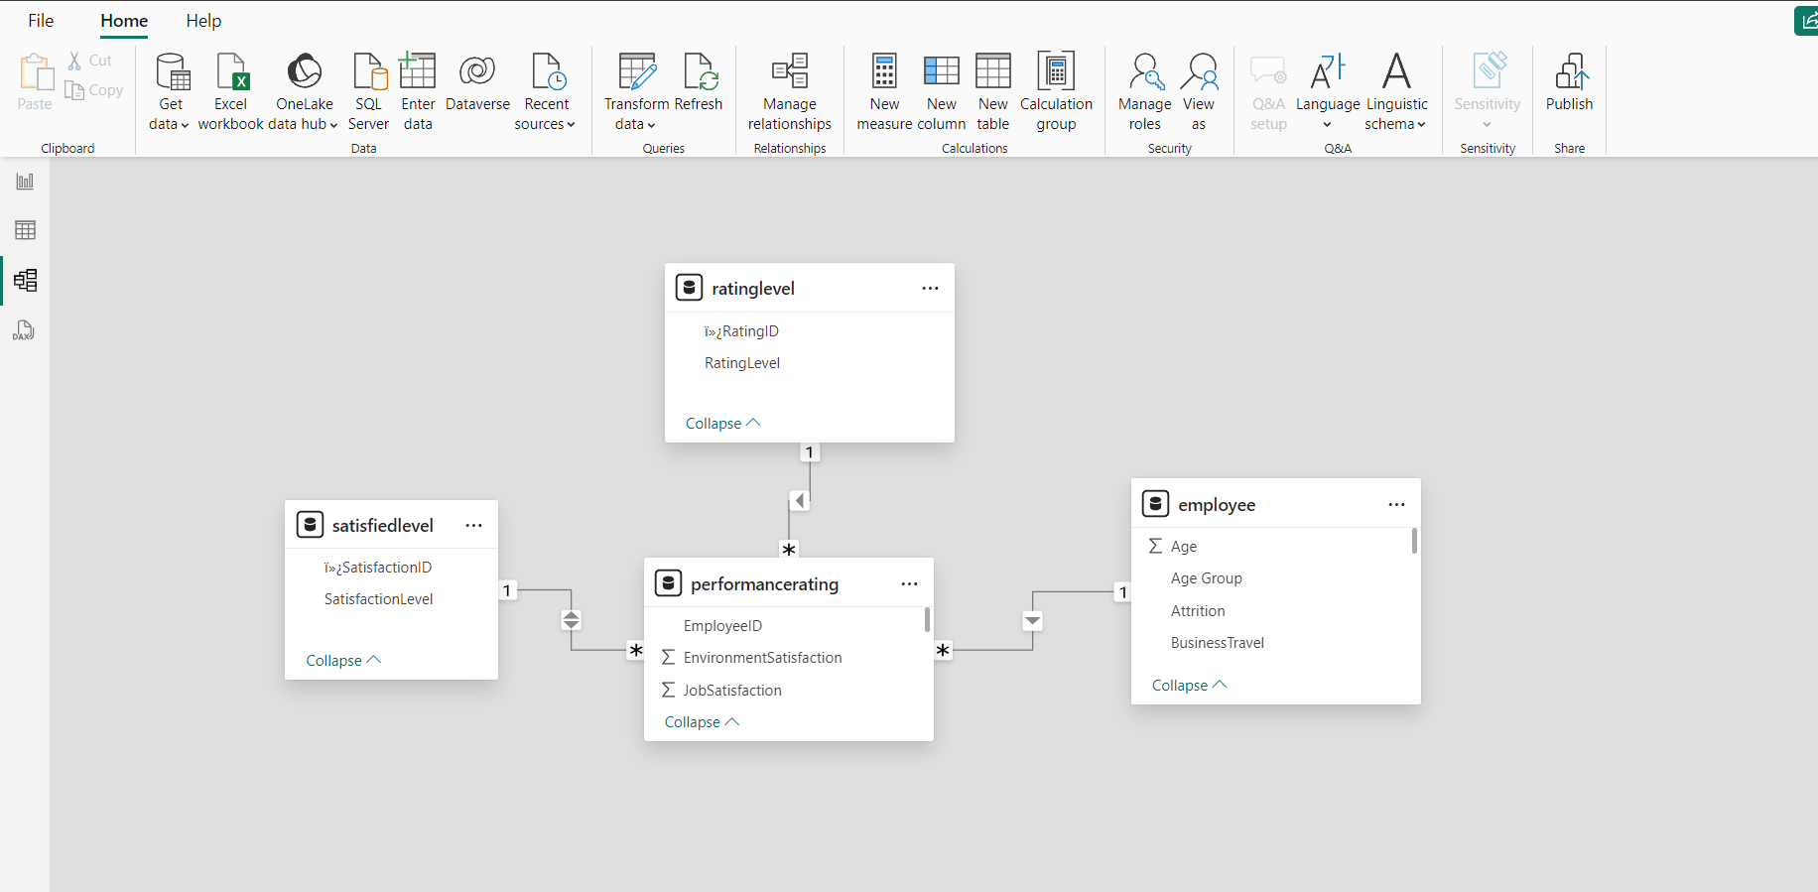
Data Modelling

